Slide 1
Winter Term 22-23 Multi-Agent Reinforcement Learning for Self-Adaptive Systems Lecture-3: Model-Free Methods - Sarsa, Double-Q-Learning, TD-Lambda
Prof. Dr. Holger Giese (holger.giese@hpi.uni-potsdam.de)
Christian Medeiros Adriano (christian.adriano@hpi.de) - “Chris”
He Xu (he.xu@hpi.de)
Sona.Ghahremani (sona.ghahremani@hpi.de)

Slide 2
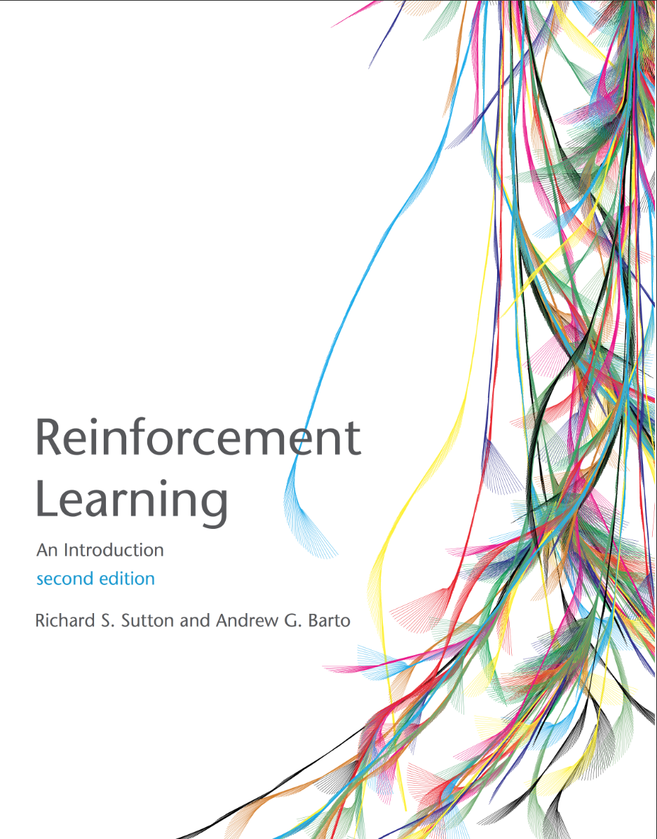
Sources used for these slides
Lectures at UCL from DeepMind Research Scientists:
David Silver, 2015, https://www.davidsilver.uk/wp-content/uploads/2020/03/MC-TD.pdf
Hado Van Hansselt, 2018 https://www.youtube.com/watch?v=nnxHlg-2WgA&list=PLqYmG7hTraZBKeNJ-JE_eyJHZ7XgBoAyb&index=4
Textbook:
Sutton & Barto 2018, An Introduction to Reinforcement Learning, MIT Press.

Slide 3
Sources
QUICK RECAP
Model-Free Evaluation Methods

Slide 4
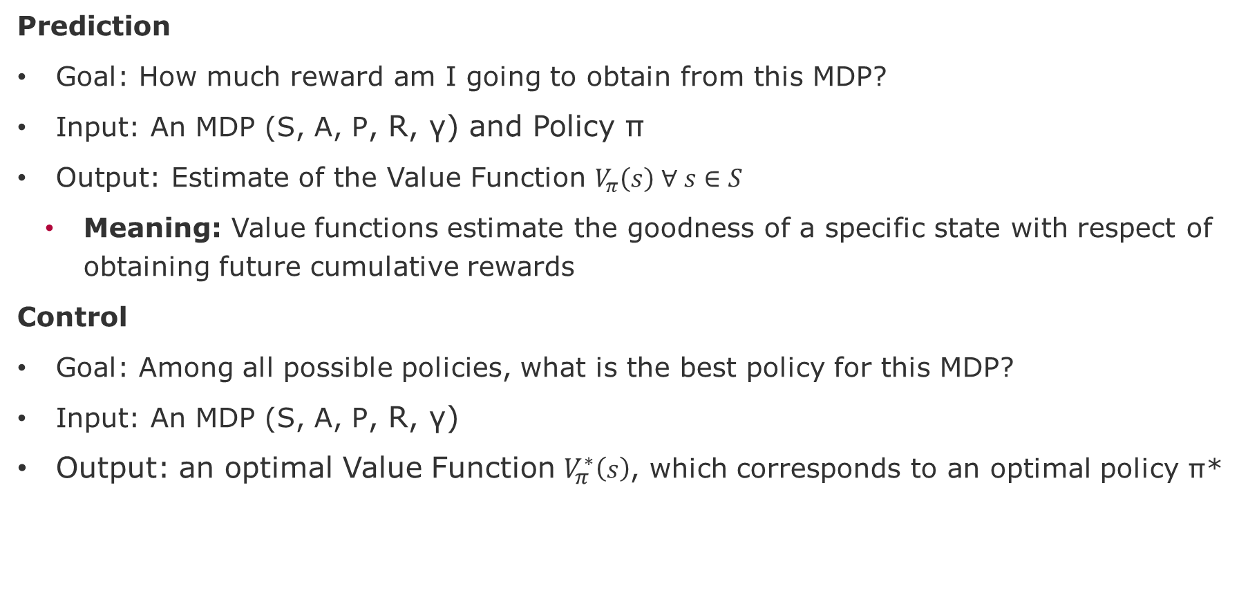
Prediction versus Control Problems
Prediction
Goal: How much reward am I going to obtain from this MDP?
Input: An MDP (S, A, P, R, γ) and Policy ϖ
Output: Estimate of the Value Function $V_{π}\left(s\right) ∀ s∈S$
Meaning: Value functions estimate the goodness of a specific state with respect of obtaining future cumulative rewards
Control
Goal: Among all possible policies, what is the best policy for this MDP?
Input: An MDP (S, A, P, R, γ)
Output: an optimal Value Function $V_{π}^{∗}\left(s\right)$, which corresponds to an optimal policy ϖ*
Control
for-loop:
policy improvement.
Prediction
policy evaluation.

Slide 5
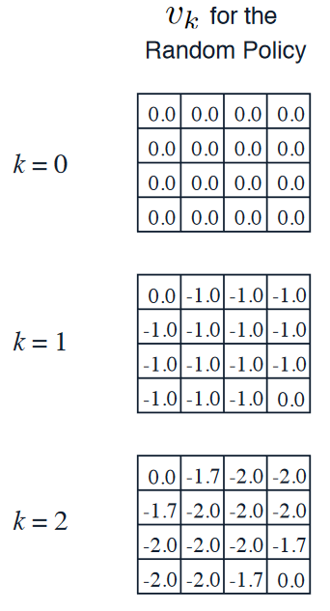
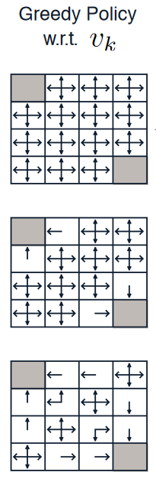
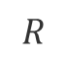
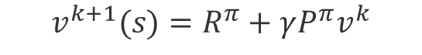
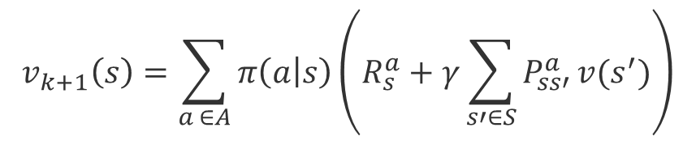
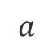
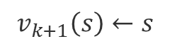

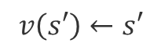
Policy Evaluation and Policy Iteration
$$v_{k+1}\left(s\right)←s$$
$$a$$
$$R$$
$$v\left(s′\right)←s′$$
One step lookahead
$$v_{k+1}\left(s\right)=\sum_{a ∈A}{π\left(a | s\right)\left(R_{s}^{a}+γ\sum_{s′∈S}{P_{ss′}^{a}}v(s^{′})\right)}$$
Evaluate:
$$v^{k+1}(s)=R^{π}+γP^{π}v^{k}$$
Improve:
$$π^{′}\left(s\right)=\max_{a ∈A}{q_{π}(s,a)}$$
Greedy!
Source: Silver, 2015, https://www.davidsilver.uk/wp-content/uploads/2020/03/DP.pdf

Slide 6
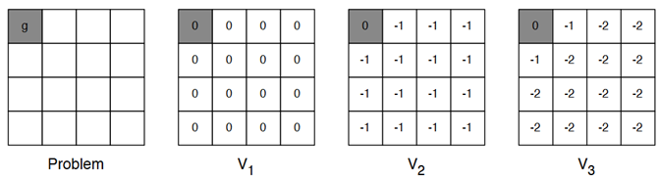
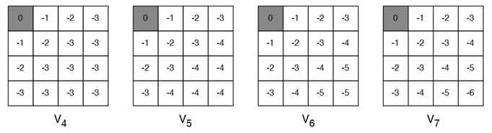
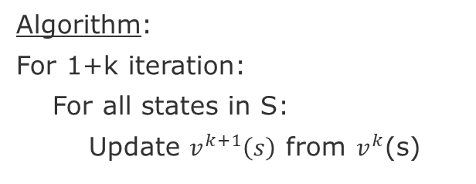
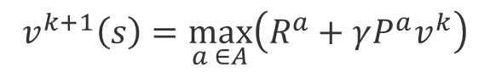
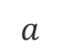
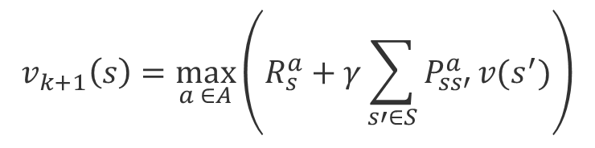

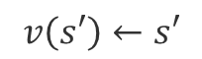
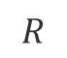
Value Iteration
$$v_{k+1}\left(s\right)←s$$
Algorithm:
For 1+k iteration:
For all states in S:
Update $v^{k+1}\left(s\right)$ from $v^{k}$(s)
$$a$$
$$R$$
$$v\left(s′\right)←s′$$
$$v_{k+1}\left(s\right)=\max_{a ∈A}\left(R_{s}^{a}+γ\sum_{s′∈S}{P_{ss′}^{a}}v(s^{′})\right)$$
$$v^{k+1}\left(s\right)=\max_{a ∈A}\left(R^{a}+γP^{a}v^{k}\right)$$
Source: Silver, 2015, https://www.davidsilver.uk/wp-content/uploads/2020/03/DP.pdf

Slide 7
Recap
Model-Free Prediction Methods

Slide 8
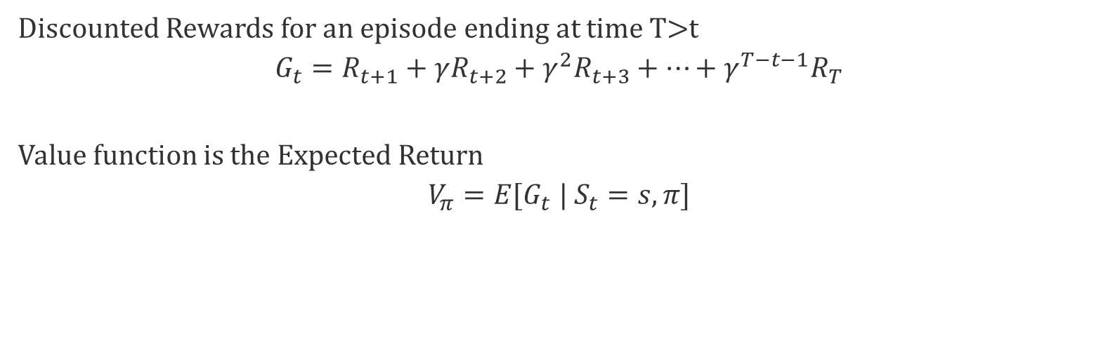
Monte Carlo Policy Evaluation
Sample the rewards for each action across multiple Episodes
Like what we have seen in the Multi-Armed Bandits
Discounted Rewards for an episode ending at time T>t
$$G_{t}=R_{t+1}+γR_{t+2}+{γ_{ }^{2}R}_{t+3}+…+{γ_{ }^{T−t−1}R}_{T}$$
Value function is the Expected Return
$$V_{π}=E{[G}_{t} | S_{t}=s,π]$$
Caveat: Multiple episodes necessary to update the state value function under a policy $V_{π}\left(S\right)$

Slide 9
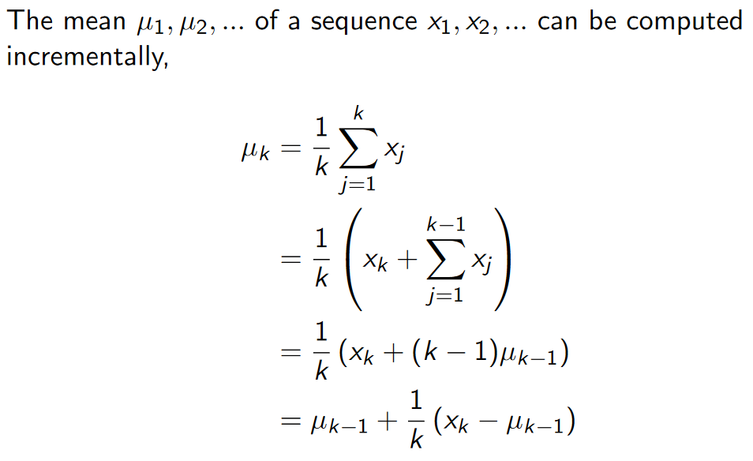
Incremental Mean
Source: Silver, 2015, https://www.davidsilver.uk/wp-content/uploads/2020/03/MC-TD.pdf

Slide 10
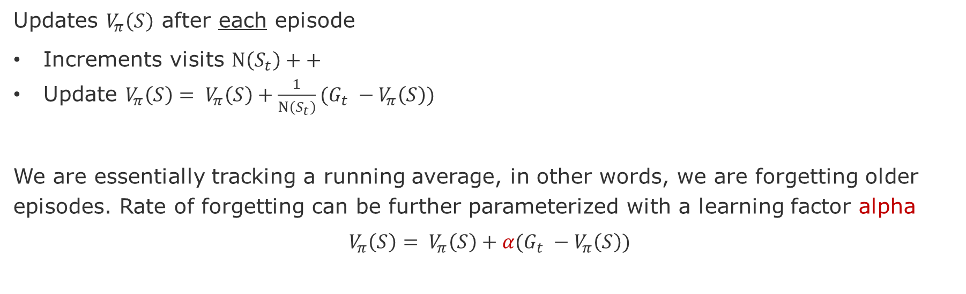
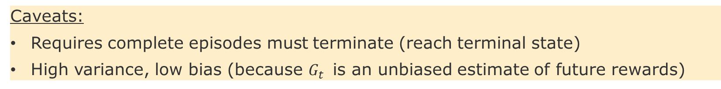
Incremental Monte Carlo Updates
Updates $V_{π}\left(S\right)$ after each episode
Increments visits $N\left(S_{t}\right)++$
Update $V_{π}\left(S\right)= V_{π}\left(S\right)+\frac{1}{N\left(S_{t}\right)}(G_{t} −V_{π}\left(S\right))$
We are essentially tracking a running average, in other words, we are forgetting older episodes. Rate of forgetting can be further parameterized with a learning factor alpha
$$V_{π}\left(S\right)= V_{π}\left(S\right)+α(G_{t} −V_{π}\left(S\right))$$
Advantages:
Non-stationary estimator
Memoryless algorithms
Caveats:
Requires complete episodes must terminate (reach terminal state)
High variance, low bias (because $G_{t}$ is an unbiased estimate of future rewards)

Slide 11
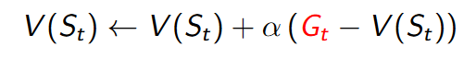
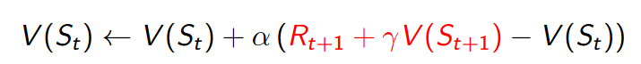
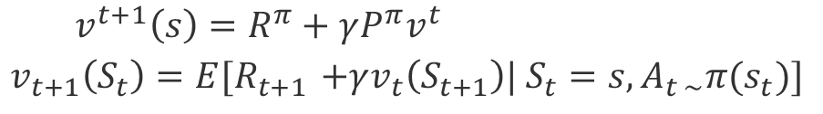
Temporal Difference Learning
Recalling Policy Iteration
$$v^{t+1}\left(s\right)=R^{π}+γP^{π}v^{t}$$
$$v_{t+1}\left(S_{t}\right)=E{[R}_{t+1 }+γv_{t}\left(S_{t+1}\right)| S_{t}=s,A_{t \sim }π{(s}_{t})]$$
Bootstrapping
Monte Carlo
TD Learning
TD-Error
Advantages:
Updates with partial episodes
Size of partial episode is parameterizable (lambda)
Caveat: High Bias, but less variance (because update depends on only one action)

Slide 12
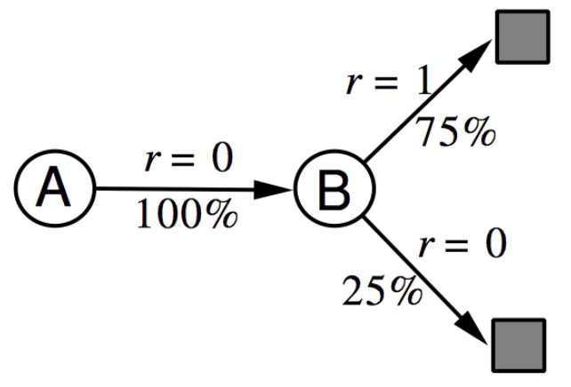
Batch Learning = Limited Budget
The batch dataset has 8 episodes with the following (state, return) values
Episode | Data
1 | (A,0), (B,0)
2 | (B,1)
3 | (B,1)
4 | (B,1)
5 | (B,1)
6 | (B,1)
7 | (B,1)
8 | (B,0)
What are the value function estimates for A and B?
Monte Carlo:
(A) = 0/8 = 0,
V(B) = 6/8 = 0.75
Temporal Difference:
V(A) = R(A) + [R(B) + V(B) - V(A)] = 0.75
V(B) = 0.75

Slide 13
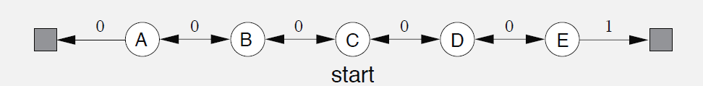
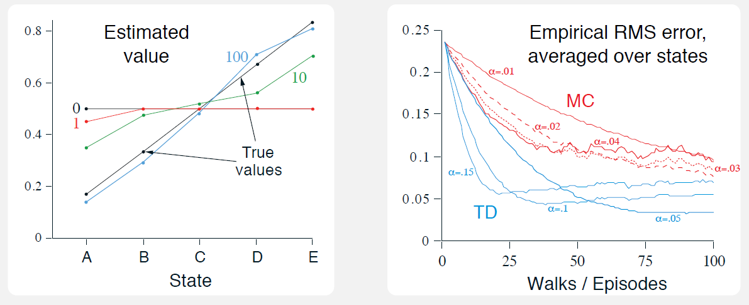
Temporal Difference (TD) vs Monte Carlo (MC)
source: page 125 [Sutton & Barto 2018]
Notes:
Left plot: TD learning approximate true value of the states (black line) after 100 steps.
Right plot:
RMSE – Root mean-squared error between the value function learned and the true value
function, averaged over the five states, then averaged over 100 runs.
Low step size makes TD and MC error curves smoother; however it takes longer to drop. Both converge to the true value, but MC is noisier (higher variance).
Larger step size makes TD approximate faster, but it stabilizes at a higher error level.

Slide 14
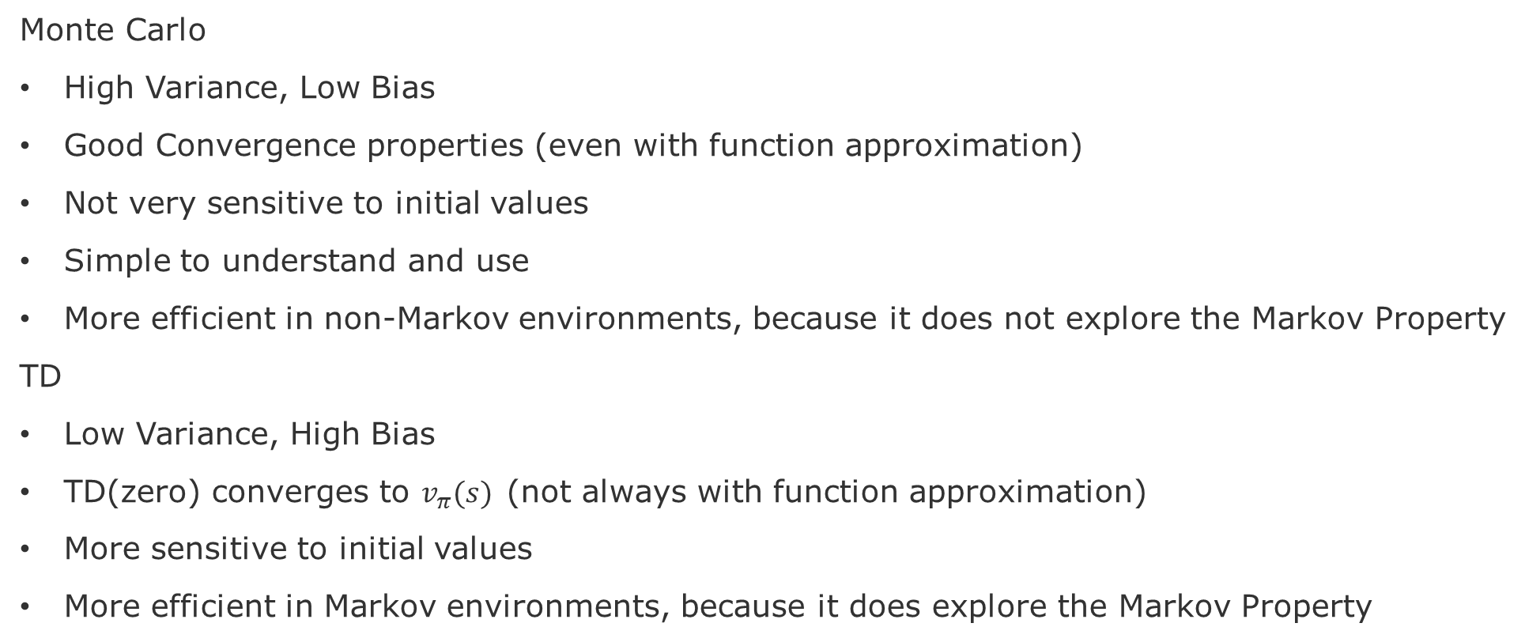
Summary of pros and cons
Monte Carlo
High Variance, Low Bias
Good Convergence properties (even with function approximation)
Not very sensitive to initial values
Simple to understand and use
More efficient in non-Markov environments, because it does not explore the Markov Property
TD
Low Variance, High Bias
TD(zero) converges to $v_{π}(s)$(not always with function approximation)
More sensitive to initial values
More efficient in Markov environments, because it does explore the Markov Property

Slide 15
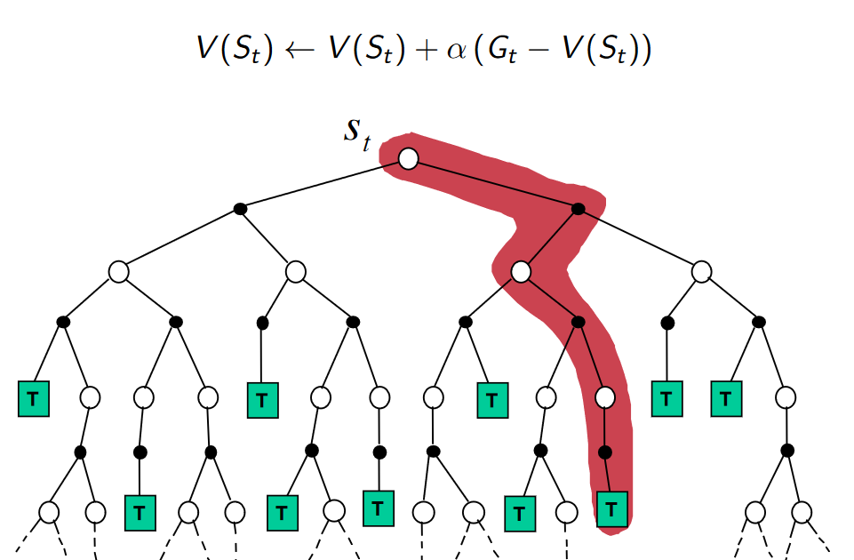
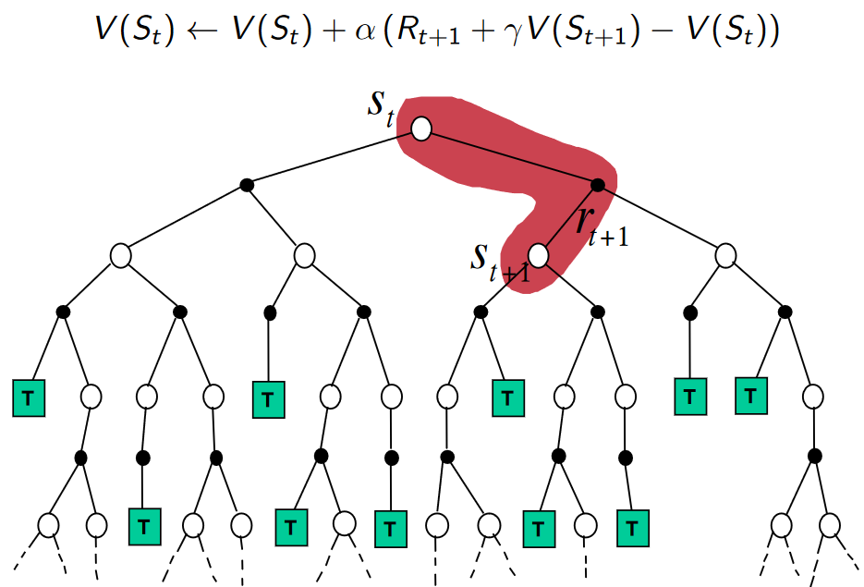
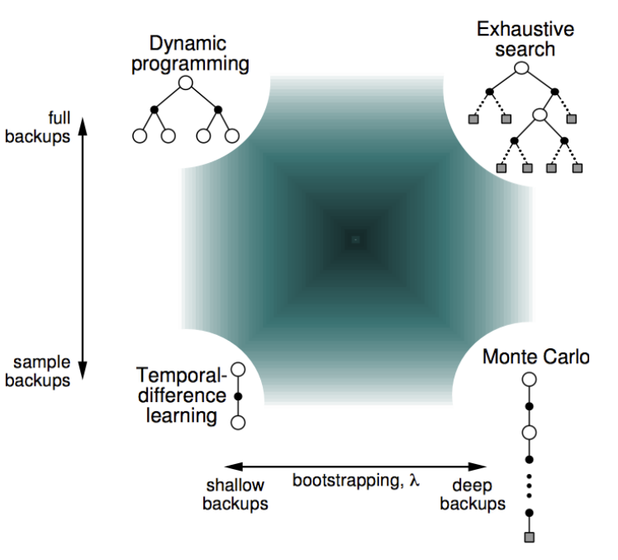
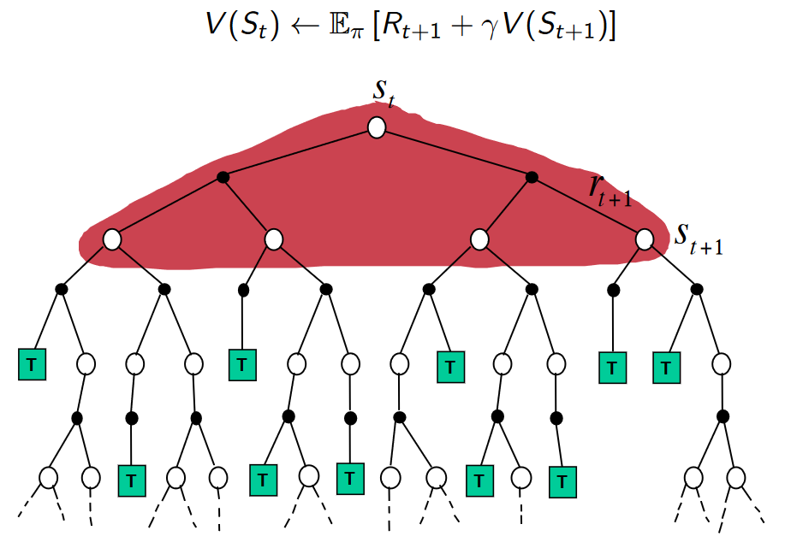
Comparing the three models
Monte Carlo
Temporal Difference
Bootstrapping: updating = to estimate
MC does not bootstrap
DP and TD bootstrap
Sampling: updating = to sample an expectation
MC and TD sample
DP does not sample
Dynamic programming

Slide 16
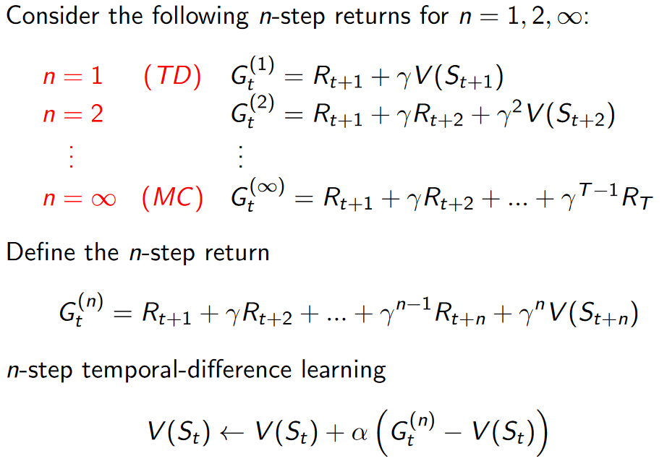
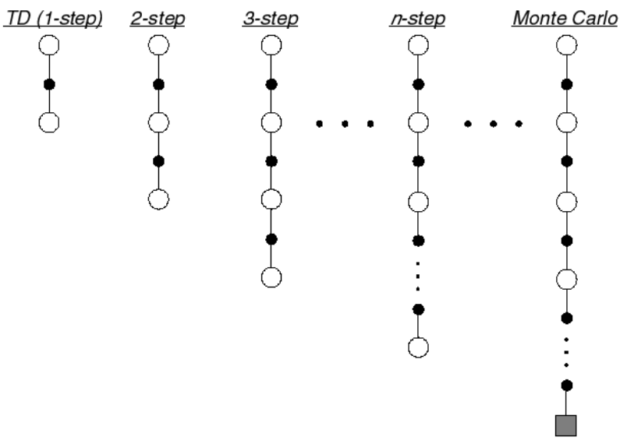
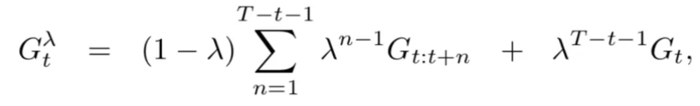
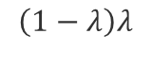
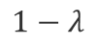
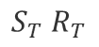
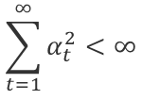
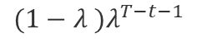
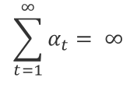
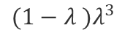
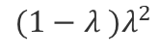
TD(lambda λ) = Trade-off between TD(0) and MC
$$1−λ$$
$$\left(1−λ\right)λ$$
𝛾 (gamma) = Discount rate
$$(1−λ )λ^{2}$$
Which n-value is the best?
$$(1−λ )λ^{3}$$
$$S_{T} R_{T}$$
$$(1−λ )λ^{T−t−1}$$
𝛼 (alpha) = Learning rate also called step size
TD is proven to converge to optimal values if we start with a large step size 𝛼𝑡 and gradually reduce it over time [Dayan & Sejnowski 1994].
Formally, TD will converge to optimal values if:
$$\sum_{t=1}^{∞}{α_{t}}= ∞$$
$$\sum_{t=1}^{∞}{α_{t}^{2}}<∞$$
Dayan & Sejnowski, 1994, TD-lambda converges with probability 1. en. Machine Learning 14:3, 295–301.
Notes:
Peter Dayan and Terrence J. Sejnowski. TD-lambda converges with probability 1. en. Machine Learning 14:3 (Mar. 1994), 295–301. issn: 1573-0565. doi: 10.1007/
BF00993978. url: https://doi.org/10.1007/BF00993978 (visited on 10/12/2022) (see page 12).
Nice short overview here: https://towardsdatascience.com/reinforcement-learning-td-%CE%BB-introduction-686a5e4f4e60

Slide 17
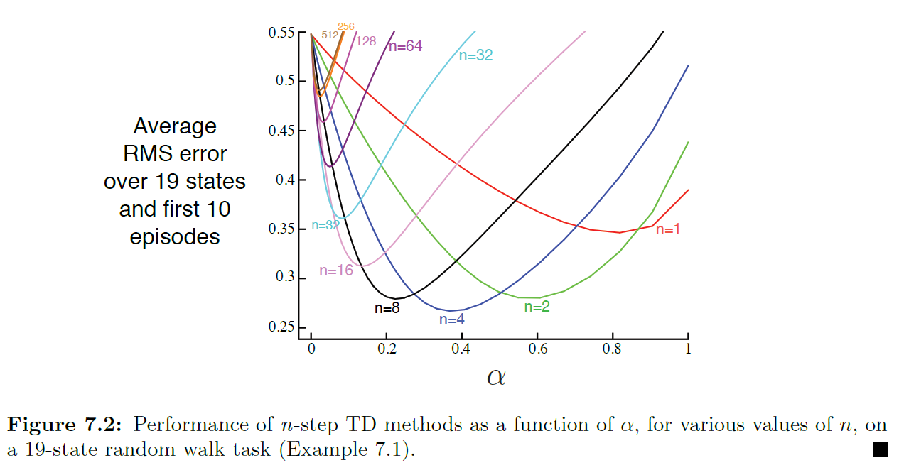
TD(λ) Which n value is the best?
source: [Sutton & Barto 2018]

Slide 18
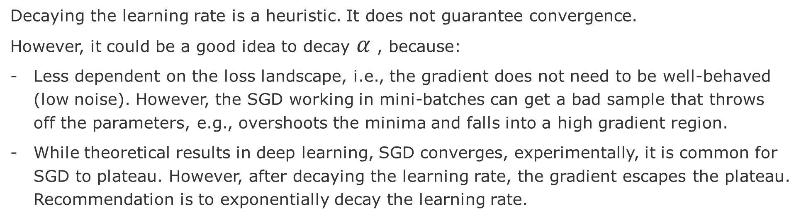
Should we decay the Learning Rate (alpha $α$)?
Decaying the learning rate is a heuristic. It does not guarantee convergence.
However, it could be a good idea to decay $α$ , because:
Less dependent on the loss landscape, i.e., the gradient does not need to be well-behaved (low noise). However, the SGD working in mini-batches can get a bad sample that throws off the parameters, e.g., overshoots the minima and falls into a high gradient region.
While theoretical results in deep learning, SGD converges, experimentally, it is common for SGD to plateau. However, after decaying the learning rate, the gradient escapes the plateau. Recommendation is to exponentially decay the learning rate.
A side note on Gradient Descend (GD) versus Stochastic Gradient Descend (SGD)
GD using smooth loss function (L2), the learning rate less is fixed to 1/(Lipschitz constant), which provably converges with an excess risk bound O(1/n) after n steps. Conversely, in SGD, the excess risk is O(1/sqrt(n)) + O(alpha * <gradient variance>). This means that there exists a "noise floor" term, O(alpha * <gradient variance>) that cannot be reduced as we take more steps. Therefore, to reduce the excess risk, we either decay the LR or reduce the gradient variance. Because the latter is not possible, one must rely on the former to increase the signal to noise ratio.
Some references:
Kochenderfer, Mykel J., and Tim A. Wheeler. Algorithms for optimization. Mit Press, 2019.
https://algorithmsbook.com/optimization/files/optimization.pdf (Book free!)
Schmidt, Mark, SGD Convergence Rate, Lecture at UBC, 2019
https://www.cs.ubc.ca/~schmidtm/Courses/540-W19/L11.pdf
Sebastian Ruder, 2016, An overview of gradient descent optimization algorithms, blog
https://ruder.io/optimizing-gradient-descent/
Notes:
Sources: https://www.reddit.com/r/MachineLearning/comments/rlxggy/d_since_gradient_continues_to_decrease_as/
In Gradient Descend

Slide 19
Control Improving the policy to find optimal value-function

Slide 20
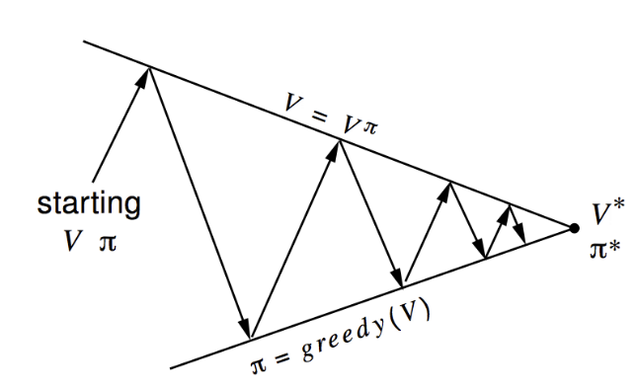
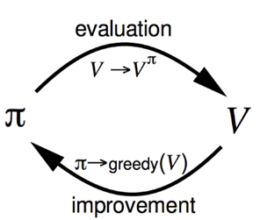
Generalized Policy Iteration
Convergence
ϖ* ==V*
Policy Evaluation:
What? estimates V^{ϖ}
How? Iterative policy evaluation
Policy Improvement:
What? generates a ϖ’ ≥ ϖ
How? Greedy policy improvement
Variations to these components:
Monte Carlo Evaluation
epsilon-Greedy (fixed exploration rate)
Monte Carlo GLIE (decaying exploratoin rate)
TD(0) and TD(lambda)
Notes:
We will vary these two components.

Slide 21
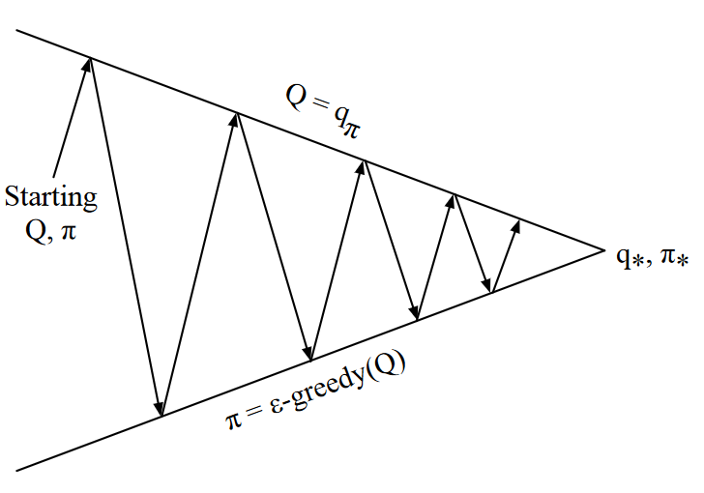
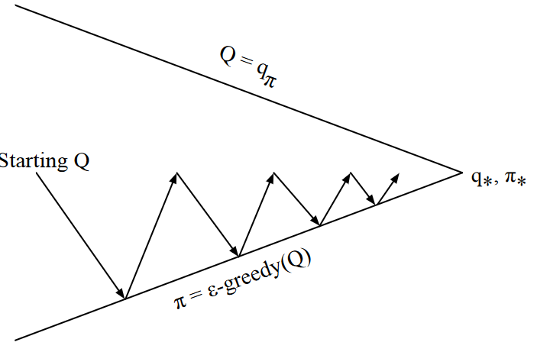

Monte Carlo Control
Solution part-1: use Q because it is based on state, action pairs
$$v^{k+1}\left(s\right)=\max_{a ∈A}\left(R^{a}+γP^{a}v^{k}\right)$$
No guarantee that will find the optimum
Control
for-loop:
Solution part-2: add randomness in the choice of action (e-Greedy)
Prediction

Slide 22

GLIE Monte Carlo Control
GLIE – Greedy in the Limit with Infinite in the limited Exploration
Decays epsilon, for instance ε
$ε=\frac{1}{k}$, where k is the episode count
All <state,action> pairs are explored indefinitely
$$\lim_{k→∞}N_{k}\left(s,a\right)= ∞$$
The policy ϖ converges to a greedy policy
$$\lim_{k→∞}{π_{k}\left(s,a\right)=I(a= \max_{a′}{q_{k}(s,a′)})}$$
Theorem shows that it also converges to the optimal value-function
$$\lim_{k→∞}{π_{k}\left(s,a\right)=I(a= \max_{a′}{q_{k}(s,a′)})}$$
Advantage: Converges to the optimal greedy policy
Caveat: Still expensive, even with partial episodes
Singh, Satinder, et al. "Convergence results for single-step on-policy reinforcement-learning algorithms." Machine learning 38.3 (2000): 287-308.
Notes:
Satinder Singh. Convergence Results for Single-Step On-Policy Reinforcement-Learning Algorithms. en (), 22 (see page 13).
Tabular SARSA and Q-learning are guaranteed to converge to the optimal policies if the agent follows a policy that is GLIE: greedy in the limit with infinite exploration [18].

Slide 23

On-Policy versus Off-Policy Learning

Slide 24





Sarsa: On-Policy TD Control
Advantage: Converges to the optimal greedy policy
Caveat: Still expensive, even with partial episodes

Slide 25

Q-Learning: off-policy TD Control
Choose among all possible actions

Slide 26
Comparing Sarsa and Q-Learning
Q-Learning does not follow any given policy to update the Q-value
However, Q-Learning still follows a “behavioral” policy in order to determine which state-action pairs to visit
Essentially:
SARSA = performs on-policy one-step TD prediction on Q-values. …More Realistic/Pessimistic!
Q-Learning = updates the Q-values by using the action with the highest expected value (i.e., the greedy action) …. More Optimistic!
Tabular SARSA and Q-learning are guaranteed to converge to the optimal policies if the agent follows a policy that is GLIE: greedy in the limit with infinite exploration [Singh 2000]
Singh, S., et al. "Convergence results for single-step on-policy reinforcement-learning algorithms." Machine learning 38.3 (2000)

Slide 27

Trade-off between Sarsa and Q-Learning
Gridworld example from [Sutton & Barto 2018] page 132.
Goal: is to go from S to G avoiding the Cliff.

Slide 28




Expected Sarsa
Asymptotic performance
10K episodes
Average over 50K runs
Uses a policy $π$ to take an average Q actions from state S’ == S_{t+1}
Interim Performance
100 first episodes
Average of 10 runs
Notes:
Expected Sarsa may completely dominate the other more-well-known TD control algorithms.

Slide 29
Comparing the three models
Monte Carlo
Temporal Difference
Bootstrapping: updating = to estimate
MC does not bootstrap
DP and TD bootstrap
Sampling: updating = to sample an expectation
MC and TD sample
DP does not sample
Dynamic programming

Slide 30



TD(λ)
Allows to look n-steps into the future:
Computing the accumulated reward:
T= step at terminal state
Generalized to a given n:
Temporal Difference
Monte Carlo
Value-Function for n-step Returns:

Slide 31



N-Steps Sarsa
For a given choice of n we will have:
Update using the n-step Q-Returns:

Slide 32





How do we decide how to distribute the updates?
Goal: Average over multiple steps, instead of only over a single step. Why?
Why?: because after each step we can have an update, instead of wait for the end of the episode
How do we generalize this?

Slide 33



Eligibility Traces
What if I would like to give more credit to certain states w.r.t to their contribution to reward?
Two heuristics: Frequency of visits and Recency of visit
More credit frequent states
More credit to recent states
Computing the Eligibility trace
Times visited

Slide 34


Intuitions and the algorithm

Slide 35


N-Step Sarsa TD(λ)

Slide 36

N-Step Q-Learning TD(λ)

Slide 37


Double Q-Learning
Problem: Q-Learning is biased towards over-estimated values
Because it uses same Q-function to select and evaluate policy
Solution:
To act, take the sum.
At each step pick randomly one of the Q-Functions to update using Q1 or Q2.

Slide 38

Double Q-Learning on Atari Games

Slide 39


Off-Policy Learning and Importance Sampling
Motivation
Follow the best policy while still exploring
Use data more efficiently, because we have a single stream of data
Reuse data from previous policies
μ Behavioral policy
(Followed)
Π = Target policy
(Explored)
Importance Sampling

Slide 40
Milestones
(Chris) Publish individual reading tasks (later today)
Lectures and cuts-to-the-chase (paper’s gist): Model-based RL, Safe RL, MARL architectures, Transfer Learning in RL
(Chris) Project Scope presentation: May 11
(Group) State-of-the-Art draft: May 25 (20 days from now)
(Group) Project proposal draft: June 01 (20 days from scope presentation)

Slide 41
Outlook on Approximation Methods
Reward does not come from a table anymore. It is estimated by a set of input parameters θ and Ω.
Value Function Approximation
Policy Gradient

Slide 42
Incremental implementations
Budget
Infinite
Finite
Model-Based
Model-Free
Finite
State Space
Model-Free or
Approximate
Approximate
Infinite

